Slide 1

Chapter 8: Interaction with Ajax
Summary from book “Beginning Rails 3 - Cloves Carneiro Jr_”

Slide 2
Sample code
Repo: git@github.com:pingovn/pingo-rails-basic.git
Branch: chapter 8

Slide 3
Overview
At end of this chapter, you could
  Interaction Rails with Ajax
  Introduce some Javascript Framework (Jquery, Angularjs, Prototype, ..)
  How to make remote Ajax calls using the remote => true options for links and forms.
  How to use javascript templates (.js.erb)

Slide 4
Ajax
Ajax = Asynchronous JavaScript and XML
Ajax is popular used in web application today. It allows page to make requests to server without refresh a page.
You could use javascript code to make a ajax request, however it is recommended to use a javascript framework. In this chapter, we will use jQuery.

Slide 5
Add jQuery to application
Download jQuery & put to “public/javascripts/jquery-1.4.2.min.js”
Add code to load jquery in application layout
  <!DOCTYPE html>
  <html>
  <head>
  <title>Blog</title>
  <%= stylesheet_link_tag :all %>
  <%= javascript_include_tag 'jquery-1.4.2.min', 'rails', 'application' %>
  <%= csrf_meta_tag %>
  </head>

Slide 6
jQuery & DOM
DOM elements could be retried by id, class or its name.
Get DOM element
  $('#article_123')
  $('.comment')
  $('div.article')
  $('div:first')

Slide 7
LAB
Target: we will practice some jQuery function by developer tool of Chrome
Steps:
  Visit a page by Chrome
  Ctrl-Shift-C to open developer tool
  Use “injector”
  Click to “console” tab, use $() to select suitable elements.
  Practise below function:
    insertAfter(target)
    insertBefore(target)
    append(content)
    prepend(content)
    slideDown()
    slideUp()

Slide 8
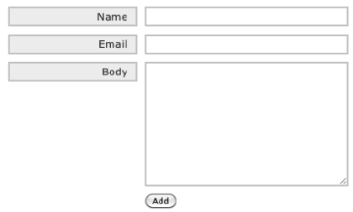
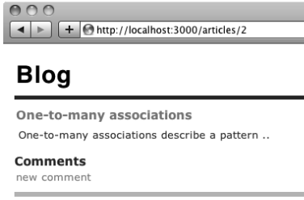
Add a new comment
/comments/new.js.erb
/articles/show.html.erb
click
/comments/new.html.erb
create

Slide 9
Without ajax
We will implement with “refresh”. After click “add” in new comment form, we redirect to article & render entire page agian

Slide 10
Article show
app/views/articles/show.html.erb
  <%= render @article %>
  <h3>Comments</h3>
  <div id="comments">
  <%= render @article.comments %>
  </div>
  <%= link_to "new comment", new_article_comment_path(@article, :format => :js), :remote => true, :id => 'new_comment_link' %>
Partial rendering
Partial rendering for list of partials

Slide 11
Article show (cont)
Explain new comment link code
  <%= link_to "new comment", new_article_comment_path(@article, :format => :js), :remote => true, :id => 'new_comment_link' %>
Above code uses below technique
  link_to : form helper for a link (<a href=“”> tag)
  new_article_comment_path : route helper for “new” method. “path” to create relative path (ex: /article/1/comment/new). You have SIMILAR helper for url. new_article_comment_url is full path (ex: http://localhost:3000/article/1/comment/new). Use *_url route helper for route without domain (ex: in case of email. Because after sending email, user needs a full path inside email)
  remote = true : don’t refresh page after “click” to this link
  id = “id_selector” : you could use $(‘#id_selector’)

Slide 12
New comment (JS)
app/views/comments/new.js.erb
  $("<%= escape_javascript render(:file => ‘comments/new.html.erb') %>“).insertAfter('#comments');
  $('#new_comment').slideDown();
  $('#new_comment_link').hide();
Explain code in detail:
  render(….) : put the render content here
  escape_javascript :
  $("<%= …%>“) : after make a comment & enter, we need to render the comment & put to comments box. After that, hide “the link”.

Slide 13
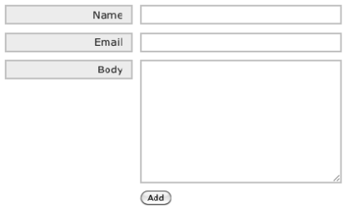
New comment (html)
apps/views/comments/new.html.erb
<%= form_for([@article, @article.comments.new],
:html => {:style => 'display: none;'}) do |f| %>
<div class="field">
<%= f.label :name %><br />
<%= f.text_field :name %>
</div>
<div class="field">
<%= f.label :email %><br />
<%= f.text_field :email %>
</div>
<div class="field">
<%= f.label :body %><br />
<%= f.text_area :body %>
</div>
<div class="actions">
<%= f.submit 'Add' %>
</div>
<% end %>

Slide 14
Comment controller
class CommentsController < ApplicationController
before_filter :load_article, :except => :destroy
def create
@comment = @article.comments.new(params[:comment])
if @comment.save
respond_to do |format|
format.html { redirect_to @article, :notice => 'Thanks for your comment' }
end
else
respond_to do |format|
format.html { redirect_to @article, :alert => 'Unable to add comment' }
end
end
end
private
def load_article
@article = Article.find(params[:article_id])
end
end
Use a filter here to save current article to @article varialbe

Slide 15
With ajax
We will implement with Ajax. After click “add” in new comment form, we request “create” method but there is no “redirect”

Slide 16
Comment controller (ajax)
class CommentsController < ApplicationController
before_filter :load_article, :except => :destroy
def create
@comment = @article.comments.new(params[:comment])
if @comment.save
respond_to do |format|
format.html { redirect_to @article, :notice => 'Thanks for your comment' }
format.js
end
else
respond_to do |format|
format.html { redirect_to @article, :alert => 'Unable to add comment' }
format.js { render 'fail_create.js.erb' }
end
end
end

Slide 17
New comment (html)
apps/views/comments/new.html.erb
<%= form_for([@article, @article.comments.new], :remote => true
:html => {:style => 'display: none;'}) do |f| %>
<div class="field">
<%= f.label :name %><br />
<%= f.text_field :name %>
</div>
<div class="field">
<%= f.label :email %><br />
<%= f.text_field :email %>
</div>
<div class="field">
<%= f.label :body %><br />
<%= f.text_area :body %>
</div>
<div class="actions">
<%= f.submit 'Add' %>
</div>
<% end %>

Slide 18
Summary
You learned
  Add jQuery to application
  Implement new comment feature in both of “refresh” & “ajax” way
  With ajax, we add “remote: true” to the form (view) and support “js” format (controller)
  You know the way to test jQuery via console of Chrome developer. In Firefox, IE there are similar tools.

Slide 19
LAB
Target: Please implement DESTROY feature to remove a comment
Tip:
  Each comment should have link to delete itself.
  Only the person who makes comment should have permission to delete it (only show the link in suitable condition). Please check it by a callback (before_filter :authenticate, :only => :destroy)
  Make refresh version of destroy at first. Then, doing with Ajax.
  Use “rake routes” to check what is the route helper of destroy (<%= link_to 'Delete', [@article, comment], :confirm => 'Are you sure?', :method => :delete, :remote => true %>)

Slide 20
LAB
Target: review what we learned by comparing current chapter branch with next branch.
And, let’s ask mentors for any unclear ☺

Slide 21
Some other JS frameworks
Prototype
AngularJS
BackboneJS

